Slide 1
Data Structures
Introduction and Necessary Background
Dr. Wedad Hussein
Information Systems Department
wedad.hussein@cis.asu.edu.eg
Dr. Hanan Yousry
Computer Science Department
hanan.hindy@cis.asu.edu.eg

Slide 2

Expectations???

Slide 3
Course Contract
Smile ☺
We are all together in this.
Classroom rules.
Everything counts.
Cheating and copying is never ok.

Slide 4
Course Information Grades Distribution
Total Grade: 100
Final Exam: 50
Year’s Work: 50
Year’s Work:
Mid-Term Exam: 15
Lab work, project and assignments 35

Slide 5
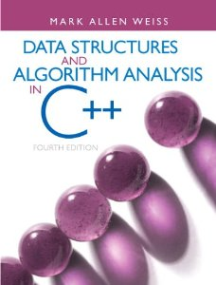
Course Information Resources
Lecture Notes.
Lecture Code.
Text Book: Data Structures and Algorithm Analysis in C++ (Fourth Edition). Mark Allen Weiss, Pearson.

Slide 6
Course Information Contents
Pointers revision + Introduction to Classes.
Stacks
Queues
Array Lists
Linked Lists
Binary Search Trees
Hash Tables
STL
Graphs

Slide 7
Course Information Course Competition
A term long competition where you collect points and the students with the highest number of points win.
How to earn points:
Special questions in the lecture.
Programming tasks.

Slide 8
Course Information Office Hours
Dr. Wedad Hussein
Sunday: 12 pm – 2pm
Office: Quality Assurance Unit-First Floor
Dr. Hanan Yousry
Sunday: 12 pm – 2pm
Office: Ground Floor Room G03

Slide 9
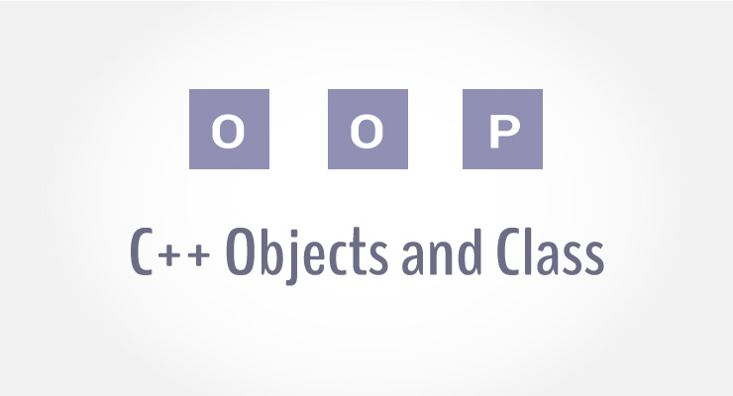
Classes

Slide 10
Introduction
A single data structure that contains data as well as functions.
A class in C++ consists of its members:
Data: Member variables.
Member functions
Declaration:
class Name {
details …
more details …
};

Slide 11
An example
Class: Rectangle.
Member Variables:
Width.
Height.
Member Functions:
Calculate Area.

Slide 12
Member Variables
class rectangle
{
private:
int width;
int height;
};
Access Modifiers
Private: The variable can’t be accessed or modified outside the class.
Only member functions can change its value.
Private vs. Public

Slide 13
Member Functions
class rectangle
{
private:
int width;
int height;
public:
int area()
{
return width*height;
}
};

Slide 14
Class vs. Object
A class defines a data type, much like a struct.
An object is an instance of the class.
They share the common structure that the class defines.
A classes is like a mold and objects are the items produced using the mold.
rectangle r1;
Class
Object

Slide 15
Constructors
A constructor is a method that describes how an instance of the class is constructed.
It is a function used to initialize the data of an object of a class.
Same name as class itself.
Cannot return anything, not even void
Called automatically with the creation of the object.
If no constructor is explicitly defined, one that initializes the data members using language defaults is automatically generated.

Slide 16
Constructors cont.
Definition:
rectangle(int wdth, int hgt)
{
width=wdth;
height=hgt;
}
Creating an Object:
rectangle r1(5,7);

Slide 17
Constructors cont.
Another way to define a constructor:
rectangle(int wdth, int hgt) :width(wdth),height(hgt) {}
Creating an Object:
rectangle r1(5,7);

Slide 18
Constructors cont.
You can have more than one constructor:
Constructor1:
rectangle(int wdth, int hgt) :width(wdth),height(hgt) {}
rectangle r1(5,7);
Constructor2:
rectangle():width(0),height(0){}
rectangle r1;

Slide 19
Destructors
A destructor is a special member function of a class that is executed when:
an object of it's class goes out of scope.
delete expression is applied to a pointer to the object of that class.
Program ends.
Is explicitly called
It can neither return a value nor can it take any parameters.
~rectangle(void){}

Slide 20
Separation of Interface and Implementation
In C++ it is common to separate the class interface from its implementation.
The interface (.h file) lists the class and its members (data and functions).
The implementation (.cpp file) provides implementations of the functions.
Source code that requires knowledge of the interface must #include the interface file.

Slide 21
Scope Resolution
Each member function must identify the class that it is part of.
The syntax is ClassName::member.
The :: is called the scope resolution operator.
The signature of an implemented member function must match exactly the signature listed in the class interface.

Slide 22

Pointers

Slide 23
What are Pointers?
A pointer variable is a variable that stores the address where another object resides.
Declaration:
num
54
int num=54, *numPtr;
numPtr = &num;
numPtr

Slide 24
Why Pointers?
Dynamic allocation of memory.
Enable complex "linked" data structures like linked lists and trees.

Slide 25
Pointer Assignment
int *p1, *p2;
p1 = p2;
p1
4
p1
4
p2
7
p2
7
*p1 = *p2;
p1
4
p1
7
p2
7
p2
7

Slide 26
Initialization
int *numPtr;
cout<<*numPtr<<endl;
int num=54;
numPtr = &num;
cout<<*numPtr<<endl;
What will this produce?
Exception!
What will this produce?
54

Slide 27
The (new) Operator
int *p1;
p1
?
p1 = new int;
p1
#
*p1 = 4;
p1
4
int *p2=p1;
p2
4
p1
p1 = new int;
p2
4
p1
#

Slide 28
Memory Leaks
C++ does not have a garbage collector.
When an object that is allocated by new is no longer referenced, the delete operation must be applied to the object.
Otherwise, the memory that it consumes is lost until the program terminates (memory leak).

Slide 29
The (delete) Operator
The delete operator deallocates the object or array currently pointed to by the pointer which was previously allocated at run-time by the new operator.
The freed memory space is returned.
The pointer still exists, the location it points to is destroyed.
delete p1;

Slide 30

Exercise
Use pointers to represent a family tree.
We need to know each person’s name as well as who their parent is.
Competition:
How would you represent your data??

Slide 31
Lecture Resources
Lecture Notes.
Lecture Code.
Text Book: Chapter 1
1.5.1
1.4.1, 1.4.2, 1.4.3

Slide 32
Thank You

